Slide 1
Fine-Tuning Pretrained Models with Hugging Face Transformers

Slide 2
Introduction to Transfer Learning
Definition: What is transfer learning?
Purpose: Why is it important in NLP?
Benefits: Time-saving, cost-effective, and performance improvements

Slide 3
Pretrained Models in NLP
Overview: Explanation of pretrained models
Examples: BERT, GPT, RoBERTa, etc.
Significance: How they have revolutionized NLP tasks

Slide 4
Introduction to Hugging Face Transformers
Overview: What is Hugging Face?
Tools: Transformers library and its components
Community: Open-source contributions and model hub

Slide 5
Fine-Tuning vs. Training from Scratch
Comparison:
- Fine-Tuning: Adjusting a pretrained model to specific tasks
- Training from Scratch: Building a model from the ground up
Advantages of Fine-Tuning:
- Requires less data
- Faster convergence
- Improved performance on specialized tasks

Slide 6
Setting Up the Environment
Tools Needed: Python, Transformers library, datasets library
Installation: Command lines for installing required packages

Slide 7
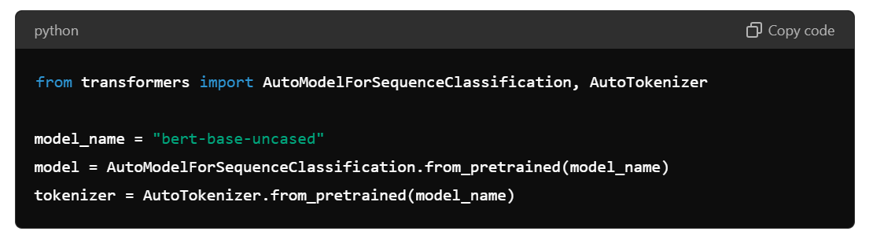
Loading a Pretrained Model

Slide 8
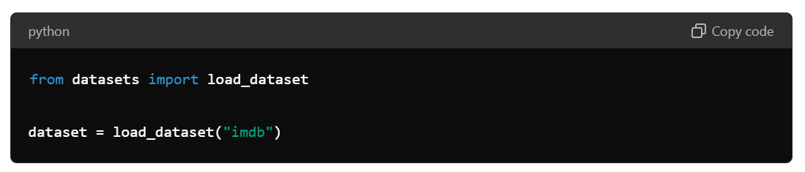
Preparing the Dataset
Dataset Choice: Selecting a dataset (e.g., IMDB, SST-2)
Loading Dataset: Using the datasets library to load and preprocess data
Code Example:

Slide 9
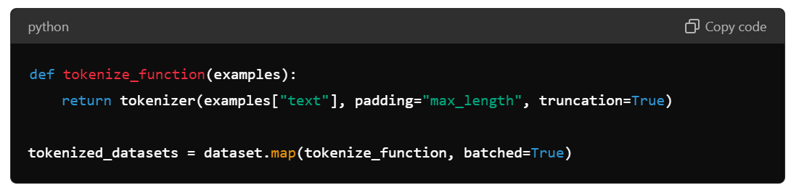
Tokenization and Data Collation
Tokenization: Converting text to tokens using the tokenizer
Data Collation: Handling batching and padding
Code Example:

Slide 10
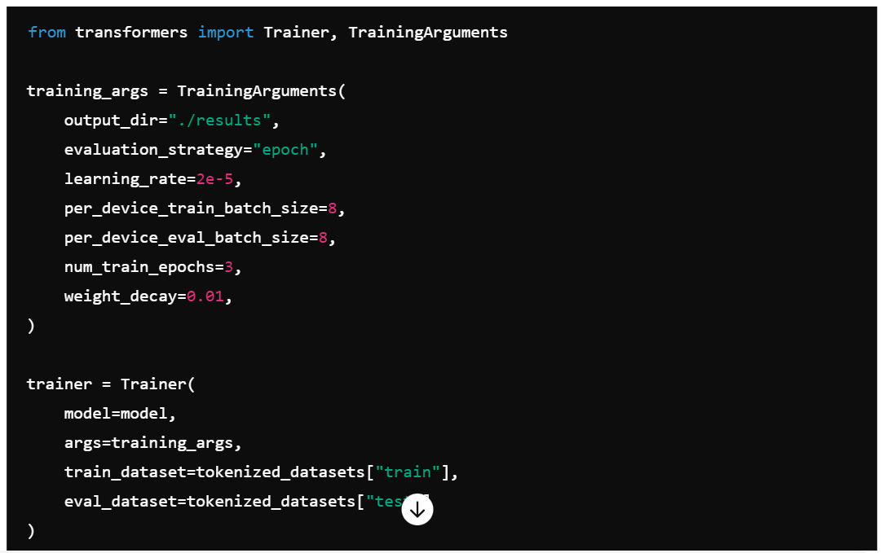
Setting Up the Trainer
Trainer API: Overview of Hugging Face's Trainer class
Components: Model, training arguments, dataset
Code Example:

Slide 11
Model: This is the model you want to fine-tune. In this case, it’s typically a transformer-based model like BERT, GPT, or RoBERTa.
Training Arguments:
These are hyperparameters and settings that control the training process. Key arguments include:
output_dir: Directory where the model checkpoints and logs will be saved.
evaluation_strategy: When to evaluate the model (e.g., after each epoch).
learning_rate: Learning rate for the optimizer.
per_device_train_batch_size: Batch size for training.
per_device_eval_batch_size: Batch size for evaluation.
num_train_epochs: Number of training epochs.
weight_decay: Weight decay for regularization.

Slide 12
Datasets:
train_dataset: The dataset used for training.
eval_dataset: The dataset used for evaluation.

Slide 13
Trainer: model=model: The pretrained model to be fine-tuned. args=training_args: The training arguments defined above. train_dataset=tokenized_datasets["train"]: The training dataset. eval_dataset=tokenized_datasets["test"]: The evaluation dataset.

Slide 14
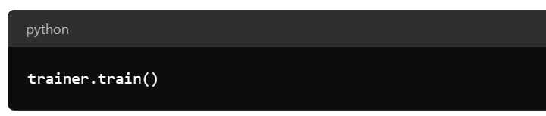
Training the Model
Process: How to train the model using the Trainer
Code Example:

Slide 15
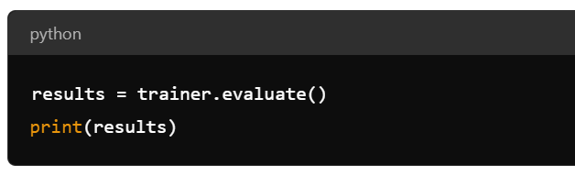
Evaluating the Model
Evaluation Metrics: Accuracy, precision, recall, F1 score
Code Example:

Slide 16
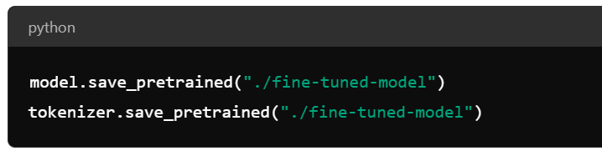
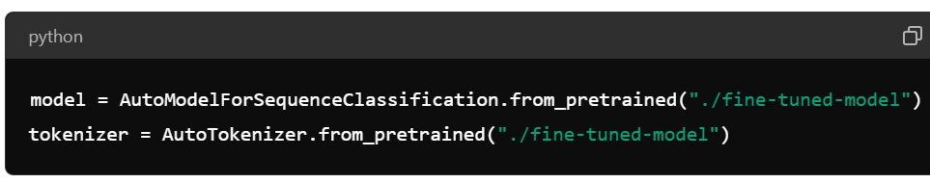
Saving and Loading the Fine-Tuned Model
Saving: Storing the model and tokenizer
Code Example:

Slide 17
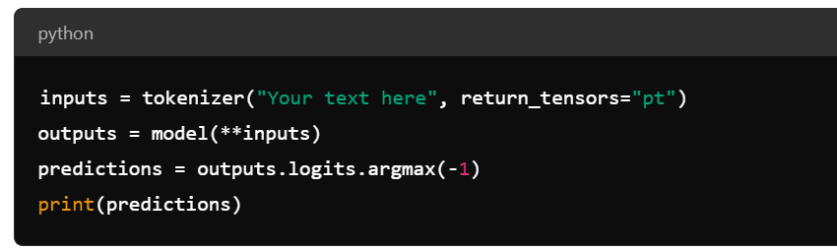
Inference with Fine-Tuned Model
Process: Using the fine-tuned model for predictions
Code Example:

Slide 18
Challenges and Best Practices
Challenges: Overfitting, data imbalance, computational resources
Best Practices: Regularization, data augmentation, monitoring metrics

Slide 19
Case Studies and Applications
Examples: Sentiment analysis, text classification, named entity recognition
Real-World Applications: Customer feedback analysis, spam detection, automated support systems

Slide 20
Resources and Further Reading
Documentation: Links to Hugging Face documentation
Tutorials: Recommended tutorials and courses
Community: Forums, GitHub repositories

Slide 21
Conclusion
Summary: Recap of key points
Future Work: Potential advancements and research directions
Q&A: Open floor for questions

Slide 22
Thank You

